Slide 1


Real-Time Operating System (RTOS) Framework for Industrial Automation
Praveen Kumar [192210546]

Slide 2
ABSTRACT
Real-Time Operating Systems (RTOS) play a pivotal role in industrial automation, ensuring precise timing, responsiveness, and safety. This presentation explores the challenges, design principles, and practical applications of RTOS in the context of industrial automation.
Leveraging priority-based scheduling algorithms and optimized interrupt handling, the framework ensures timely execution of critical tasks, essential for seamless integration with industrial control systems.
Designed to meet the stringent requirements of real-time control systems, this framework prioritizes deterministic task scheduling, efficient resource management, and fault tolerance mechanisms.

Slide 3
INTRODUCTION
In today's industrial landscape, the need for precise control and rapid response in automation processes is paramount. Real-Time Operating Systems (RTOS) play a crucial role in meeting these demands by facilitating deterministic task execution and low-latency communication, essential for industrial automation.
However, developing RTOS frameworks for industrial environments requires addressing diverse challenges such as managing concurrent tasks and ensuring fault tolerance and safety compliance.

Slide 4
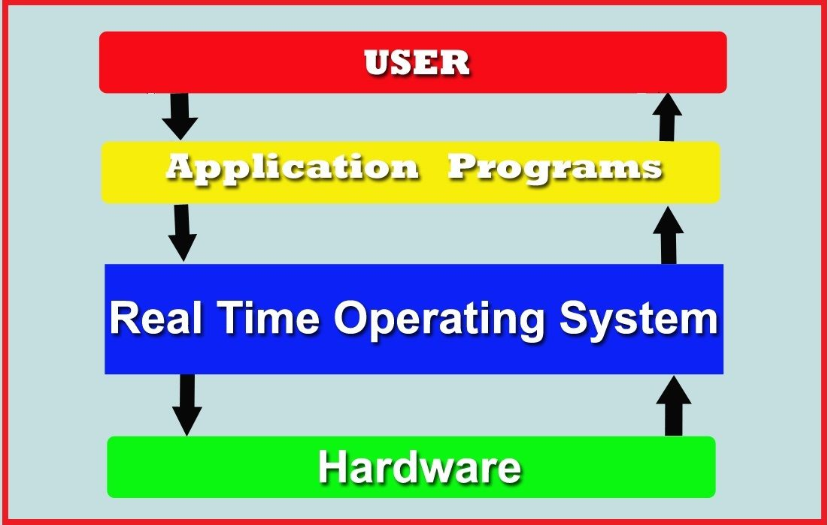
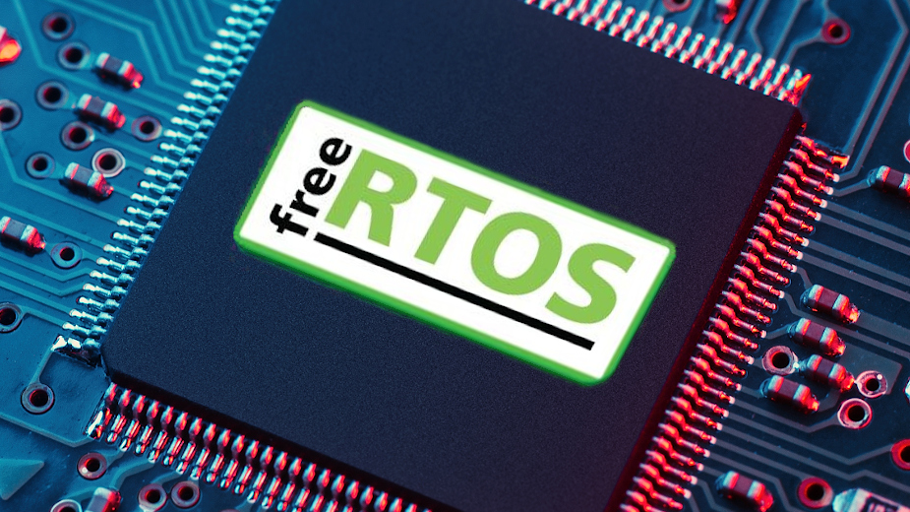
Industrial automation environments demand robust frameworks capable of orchestrating complex operations with precision and reliability.
The development of an RTOS framework tailored to these specific needs holds the promise of transforming how industries approach real-time control and monitoring.
By tackling the distinct challenges of industrial automation, such a framework has the potential to enhance efficiency, safety, and scalability across various manufacturing and process industries.

Slide 5
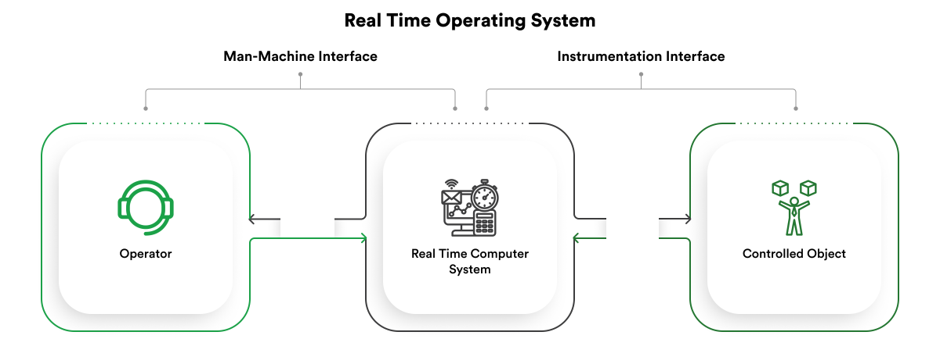
Industrial Automation Challenges
Precision Struggle: The demand for precise synchronization in high-speed robotic movements is key. Even slight deviations can lead to misalignments, defective products, and decreased throughput.
Safety-Criticality: Safety standards (such as ISO 26262) require efficient and consistent development across the entire lifecycle.
Jitter and Timing Variations: Unpredictable timing variations (jitter) threaten accuracy, especially in scenarios where milliseconds matter.

Slide 6
Objectives
Ensure deterministic task execution for timely responses in industrial automation processes.
Develop low-latency communication mechanisms for rapid data exchange.
Implement robust fault tolerance mechanisms to enhance system reliability.
Optimize resource management for efficient CPU, memory, and system resource utilization.
Support integration with industry-standard communication protocols.
Incorporate safety-critical features compliant with industry standards.
Design the framework to be scalable and adaptable to various system sizes and complexities.

Slide 7
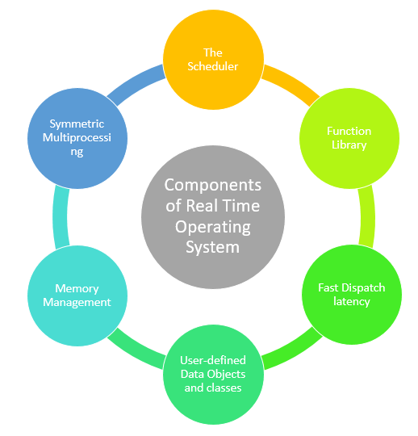
Design Principles

Slide 8
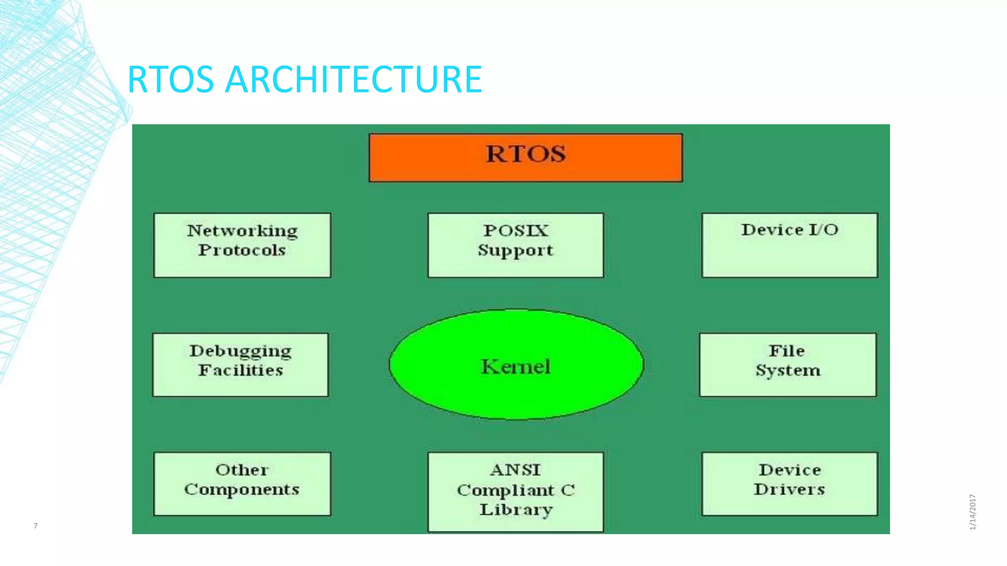
RTOS Architecture
Kernel: Core component managing task scheduling, memory, and communication.
Task Scheduling Algorithms: RMS, EDF, and DMS for precise execution.
Jitter Mitigation: Strategies to minimize unpredictable timing variations.

Slide 9
Applications
Robotic Arms: High-speed movements in manufacturing and assembly.
Autonomous Mobile Robots (AMRs): Efficient navigation and control.
Drones: Precision in aerial operations.
Automated Guided Vehicles (AGVs): Seamless kernel execution across cores.

Slide 10
Problem
The primary challenge for an RTOS framework in industrial automation is ensuring deterministic task execution while maintaining reliability, safety, and scalability. This encompasses minimizing task scheduling overhead, reducing communication latency, implementing robust fault tolerance mechanisms, optimizing resource management, integrating with industry-standard protocols, ensuring safety compliance, and designing for scalability. Achieving a balance among these requirements within the constraints of real-time control systems poses a substantial technical and engineering hurdle.

Slide 11
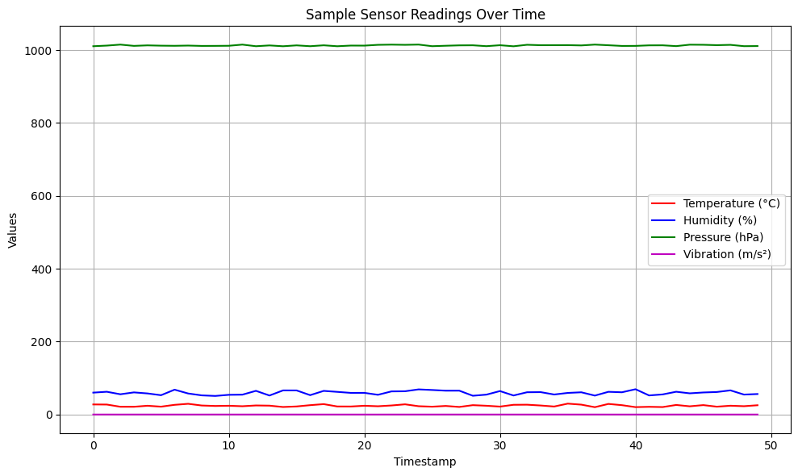
Output graph

Slide 12
Future scope
Edge Computing Integration: Enhance RTOS frameworks to support real-time processing and decision-making at the network edge, optimizing task scheduling and resource management algorithms.
Cyber-Physical Systems (CPS): Evolve RTOS frameworks to better support the development of cyber-physical systems, ensuring seamless interaction between cyber and physical components.
Machine Learning and AI: Integrate ML/AI techniques into RTOS frameworks for predictive maintenance, anomaly detection, and process optimization, while ensuring efficient execution within real-time constraints.
Security Enhancement: Incorporate robust security features into RTOS frameworks to protect against cyber threats, including intrusion detection, secure communication protocols, and encryption mechanisms.
Interoperability with Standards: Ensure RTOS frameworks comply with industry-standard communication protocols (e.g., OPC UA, MQTT) for seamless integration with existing industrial automation systems and devices.

Slide 13
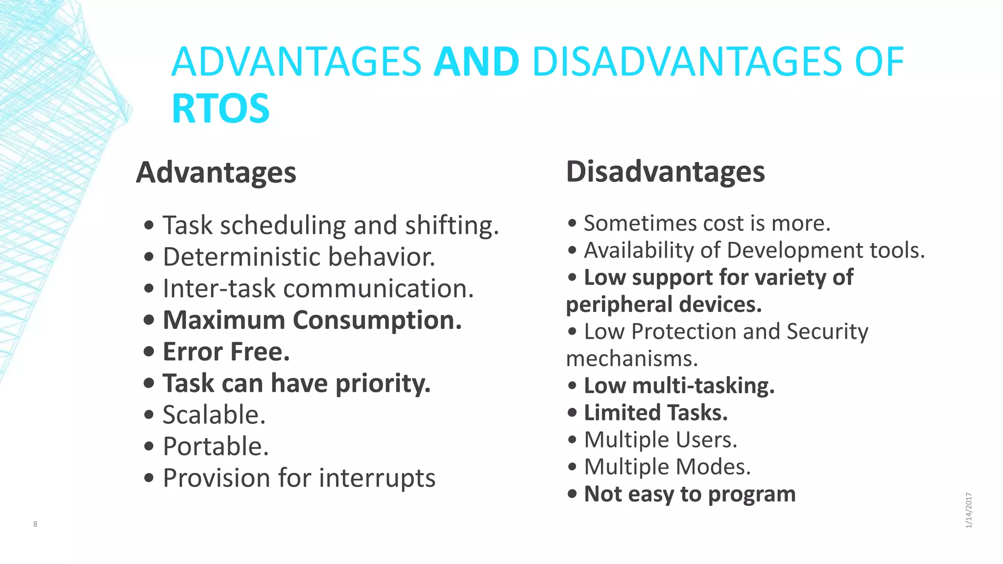

Slide 14
Result
Integrating edge computing for real-time processing and enhanced system responsiveness.
Evolving to support cyber-physical systems, enabling advanced automation and control.
Incorporating machine learning and AI for predictive maintenance and process optimization.
Prioritizing robust security, interoperability, energy efficiency, and real-time analytics for improved system performance and reliability.
Enhanced precision, safety, and efficiency in industrial automation.

Slide 15
Conclusion
Real-Time Operating Systems are indispensable for achieving precision, safety, and productivity in the dynamic landscape of industrial automation. By embracing RTOS principles, we pave the way for Industry 5.0’s collaborative future between humans and robots.
Feel free to explore further or ask for specific details!

Slide 16


